Slide 1
Introduction to Forces

Slide 2

By the end of this lesson, you should be able to:
Explain happens when a force is applied to an object.
Recall how forces are represented.
Recall the unit of force.
Identify when a balanced net force is produced.

Slide 3
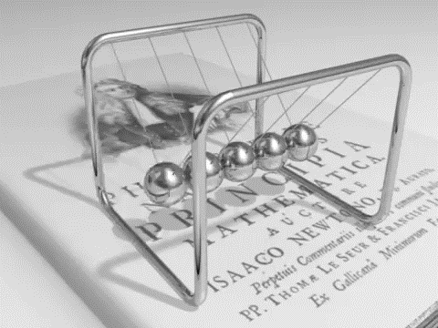
A force is a push or pull applied by one object to another object.
We may not be able to see forces, but we know that they are there because they change the speed or direction that an object is travelling in.
Forces can also change the shape of objects.

Slide 4
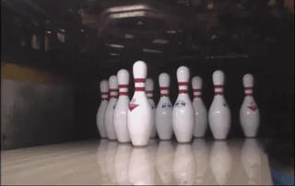
When you push a bowling ball, you apply a force to it that makes it start moving.
Then the bowling ball applies another force to the pins when it hits them. This makes the pins fall over.

Slide 5
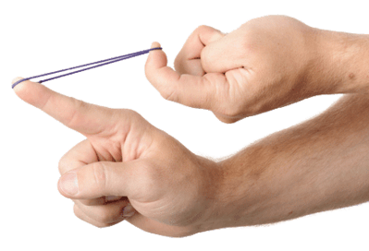
When you pull a rubber band, it stretches. This makes the rubber band change its shape.
A force is anything that changes the speed, direction or shape of an object.

Slide 6
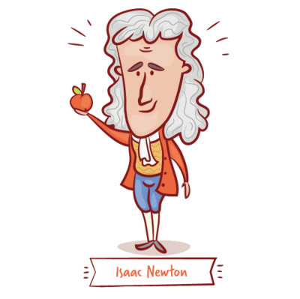
We measure force in newtons, which have the symbol N.
A large force has more newtons than a small force.
Newtons were named after Isaac Newton, the famous physicist. Newton worked out loads of really important scientific ideas. Later in this folder, we will learn about his Laws of Motion, which explain how forces work.

Slide 7
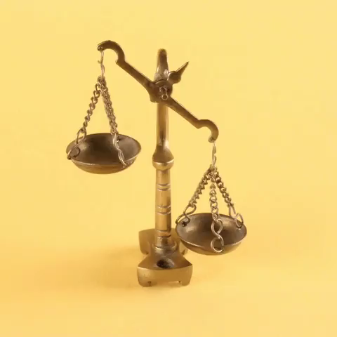
Sometimes two or more forces act on the same object, resulting in a net force acting on the object.
A net force is another way of saying "the sum of forces acting on an object".
These forces can be either balanced or unbalanced.

Slide 8
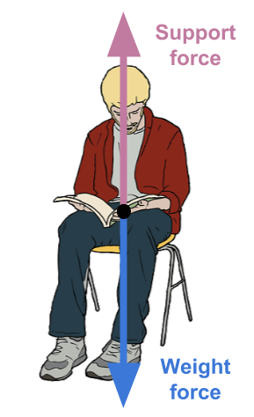
Forces are balanced when they are the same size and act in opposite directions. Balanced forces produce a net force of 0 N.
For example, when you sit on a chair, the weight force acting on you is the same size as the support force from the chair. These forces point in opposite directions, so they are balanced.

Slide 9
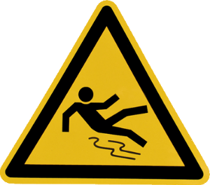
If the chair disappeared from under you, there would be an unbalanced net force acting on you.
This is because the weight force is still acting on you, but there is no support force to balance it!

Slide 10
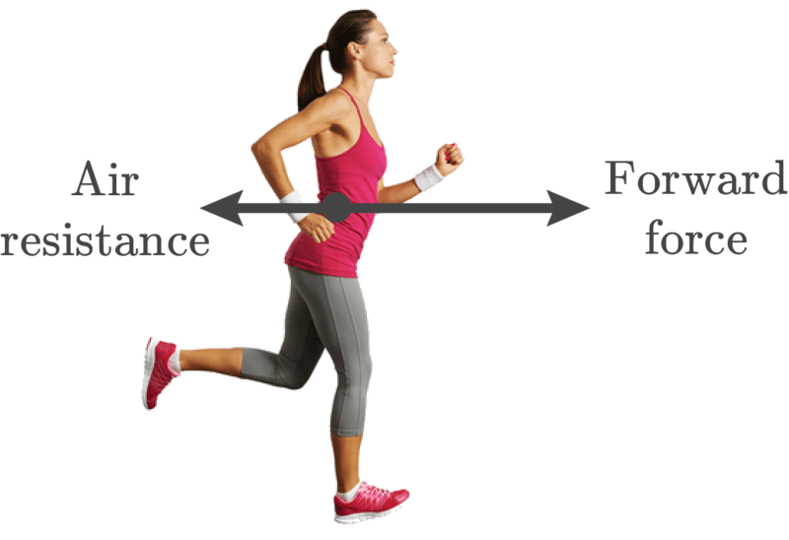
An object experiences a change in motion (acceleration) when an unbalanced net force acts on it.
This means that the object could speed up or slow down.
In the example below, the arrows are different sizes, which shows that the forces are unbalanced. Since the forward force is larger than air resistance, the runner moves forward.

Slide 11
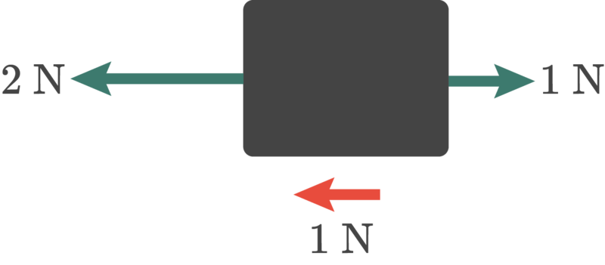
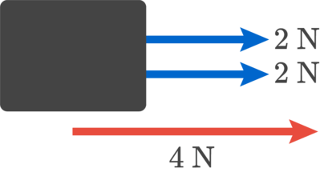
Summing Forces:
When two or more forces act of an object, we add their vectors together to get the net force.
When two forces are applied in the same direction, we simply add them together.
When forces are applied in opposite directions, we subtract them.
Note: We are actually still adding them together. However, because the force vectors are in opposite directions, one of them contains a negative sign. Remember that adding a negative number is the same as subtracting a positive one.

Slide 12
